Slide 1
Monday, October 4th , 2021
Unit 3: AT HOME
Getting started - Read
I. Vocabulary
chore = housework (n):
sink (n):
frying pan (n):
saucepan (n):
rice cooker (n):
steamer (n):
stove (n):
safe (adj):
→safety (n):
→ safely (adv):
dangerous (adj):
→ danger (n):
→ dangerously (adv):
precaution (n):
chemicals (n):
drug (n):
destroy (v):
→ destruction (n):
injure (v):
→ injury (n):
socket (n):
match (n):
scissors (n):
objects (n):
bead (n):
keep (sth) out of children’s reach:

Slide 2
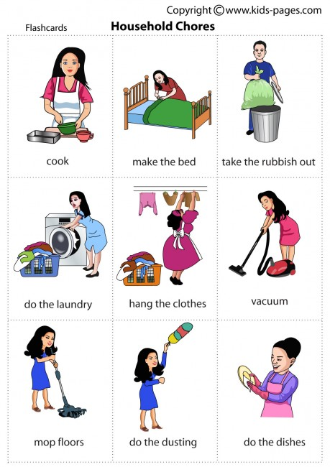
Vocabulary
housework (n)
=
chore (n)

Slide 3
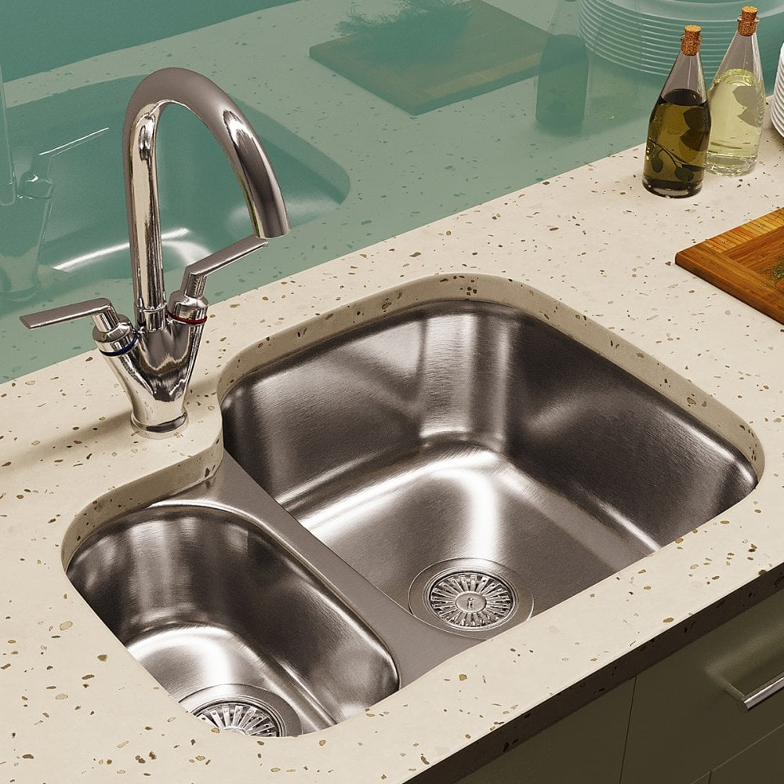
Vocabulary
sink (n)

Slide 4
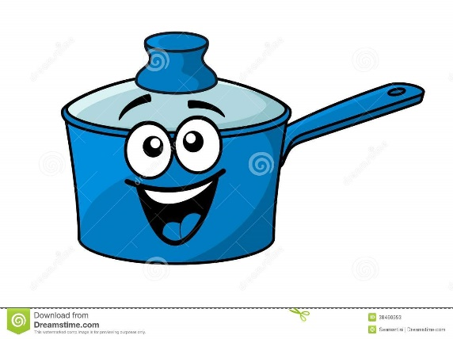
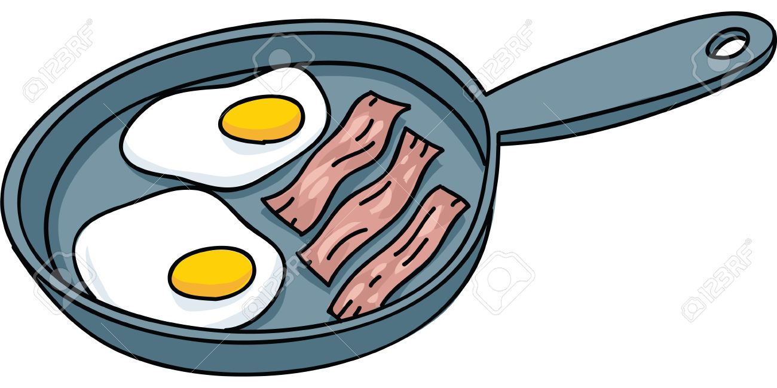
saucepan (n)
frying pan (n)

Slide 5
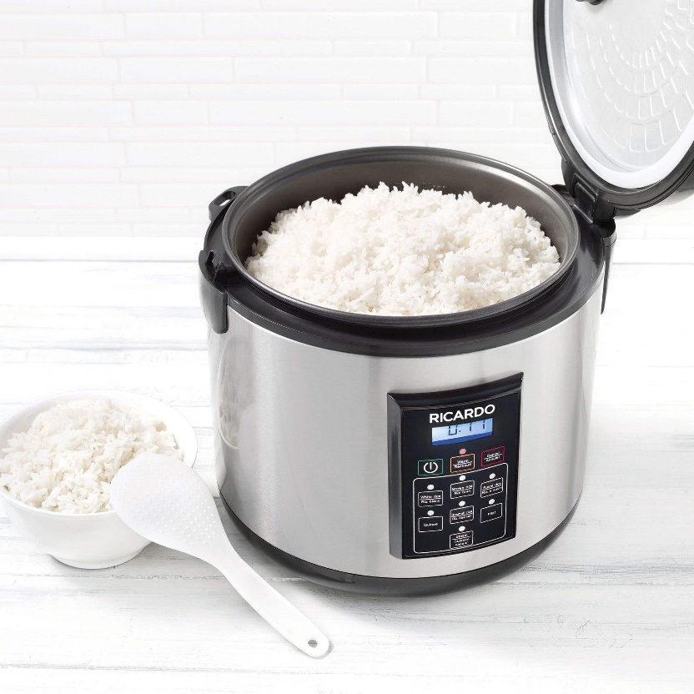
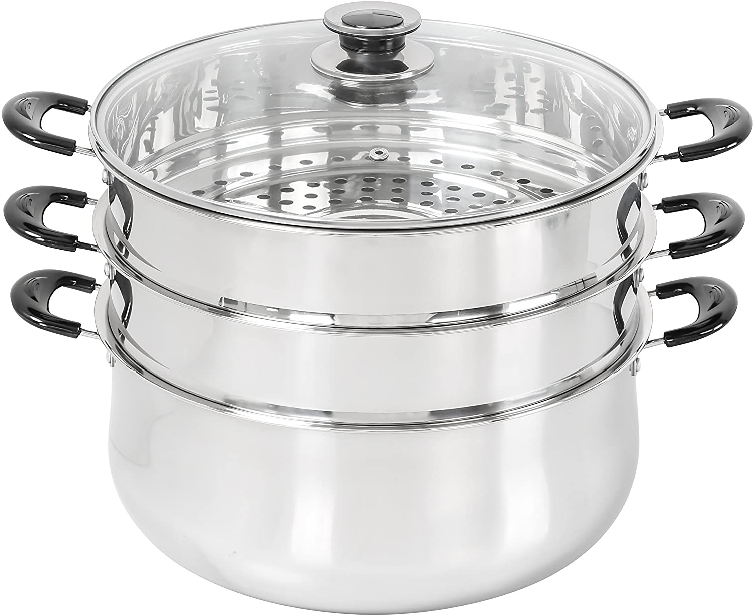
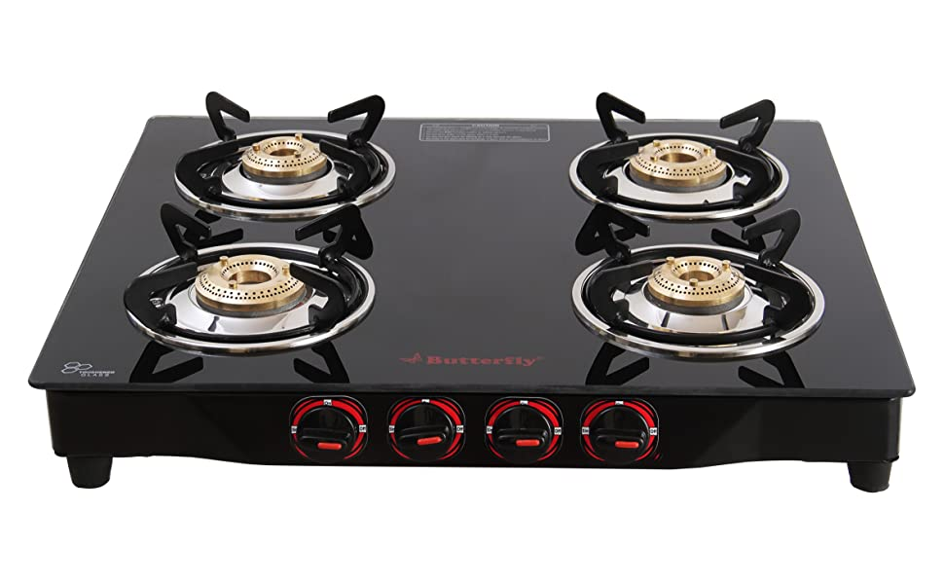
rice cooker (n)
steamer (n)
stove (n)

Slide 6
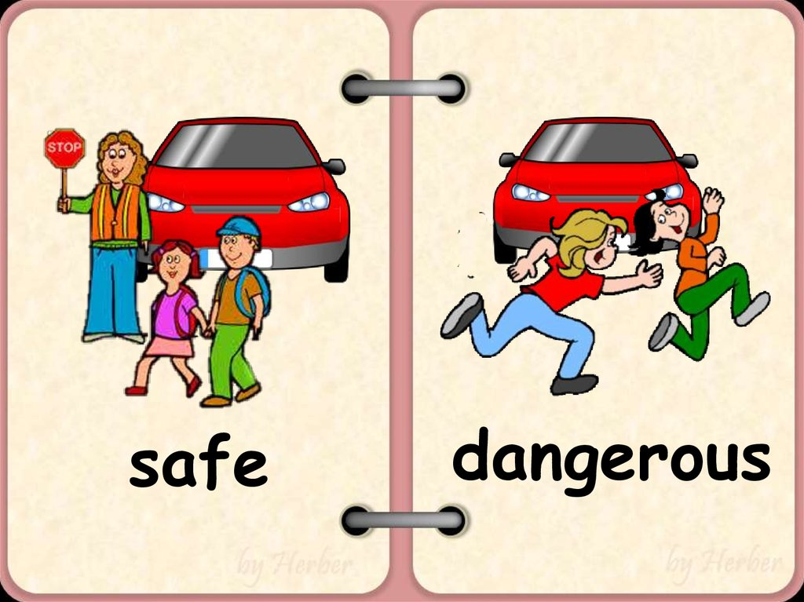
safe (adj)
→ safety (n)
→ safely (adv)
dangerous (adj)
→ danger (n)
→ dangerously (adv)

Slide 7
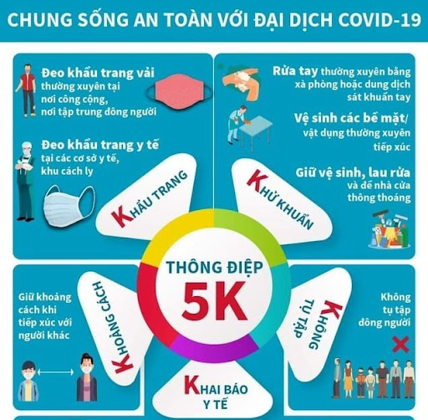
Coronavirus Precaution tips
precaution (n)

Slide 8
chemicals (n)

Slide 9
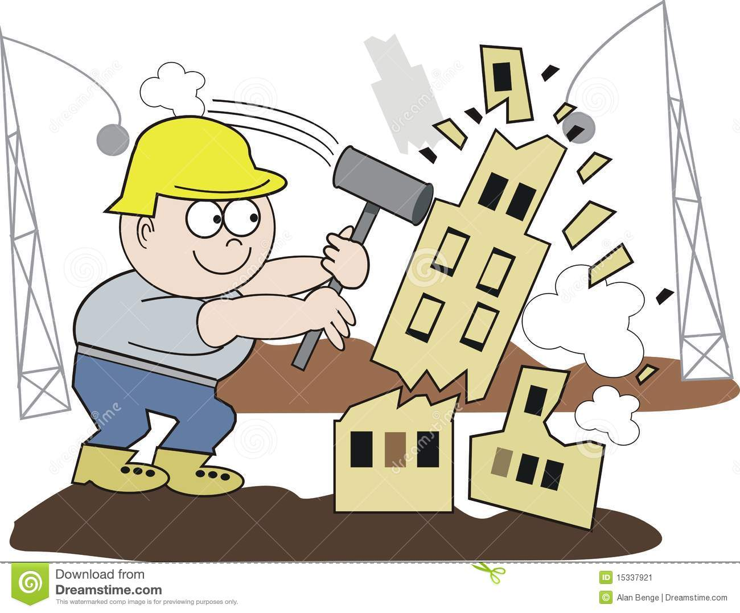
destroy (v)
→ destruction (n)

Slide 10
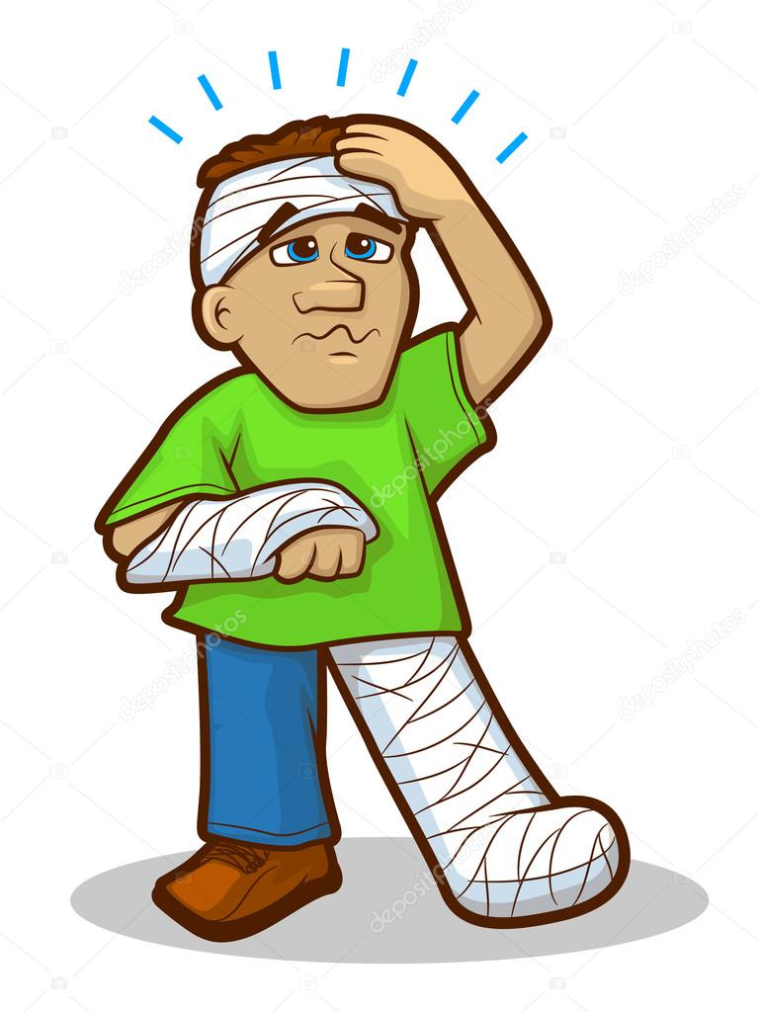
injure (v)
→ injury (n)

Slide 11
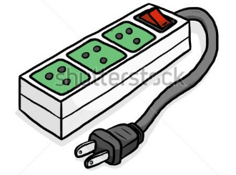
socket (n)

Slide 12
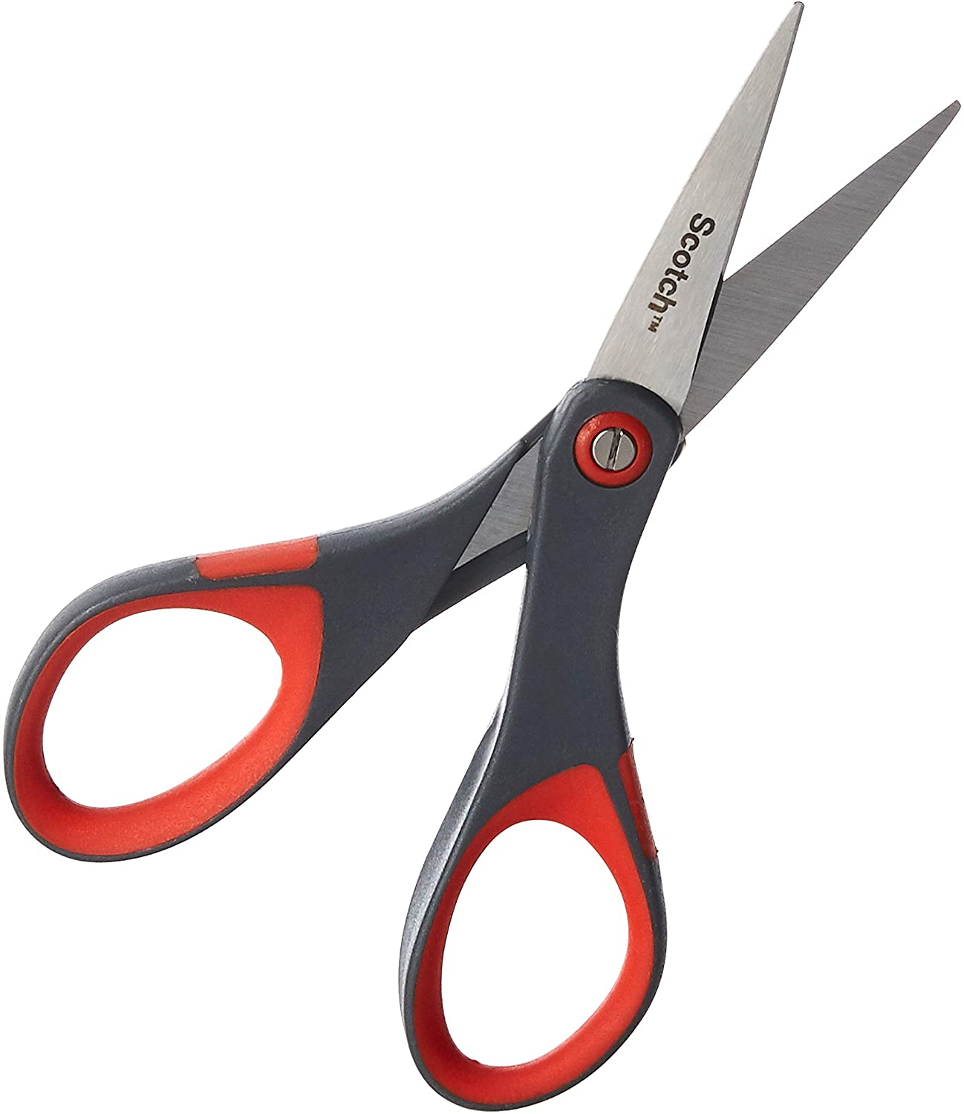
scissors (n)

Slide 13
match (n)

Slide 14
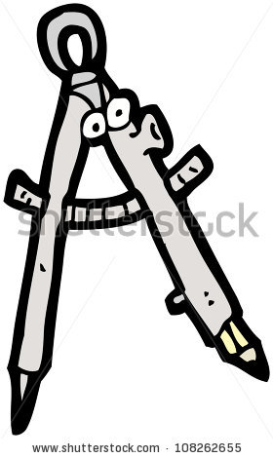
objects (n)

Slide 15
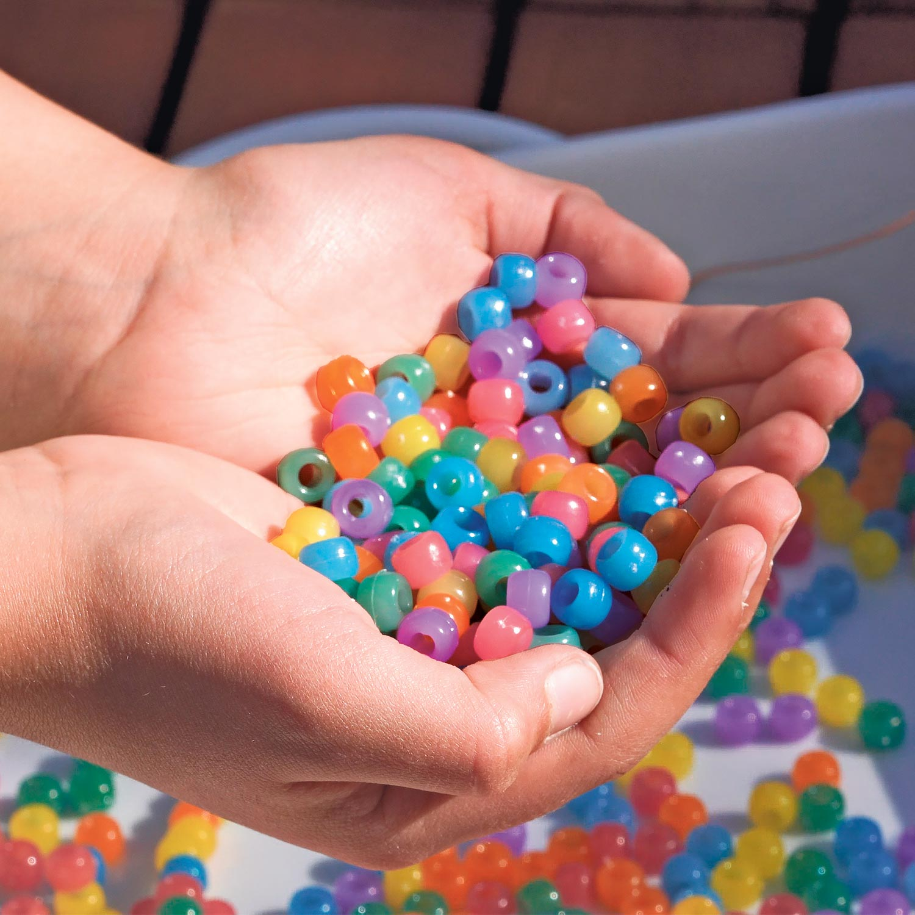
bead (n)

Slide 16
keep sth out of children’s reach
keep out of children’s reach

Slide 17
chore (n)
precaution (n)

Slide 18
destroy (v)
→ destruction (n)
sink (n)

Slide 19
safe (adj)
→ safety (n)
→ safely (adv)
injure (v)
→ injury (n)

Slide 20
chemicals (n)
keep out of children’s reach

Slide 21
SAFETY PRECAUTIONS
in the home

Slide 22
READING

Slide 23
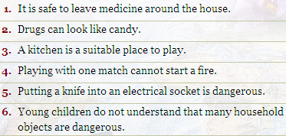
True/ false statements prediction
SAFETY PRECAUTION IN THE HOME

Slide 24
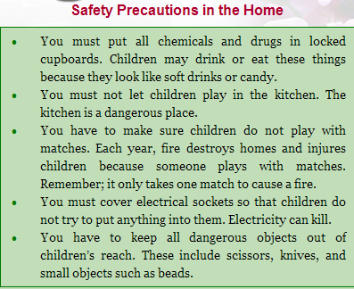

Slide 25
READING AND CHECKING
It is safe to leave medicine around the house.
False →
Drugs can look like candy.
3. A kitchen is suitable place to play.
False →
4. Playing with one match cannot start a fire.
False →
5. Putting a knife into an electrical socket is dangerous.
6. Young children do not understand that many house hold objects are dangerous.
in locked cupboard
True
dangerous
can
True
True

Slide 26
LUCKY NUMBERS
1 2 3
4 5 6

Slide 27
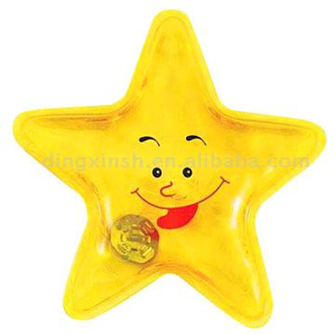
1. Why must we put all chemicals and drugs in locked cupboards?
→ Because children often try to eat and drink them.

Slide 28
Lucky number!!!

Slide 29
2. Why mustn’t we let children play in the kitchen?
→ Because the kitchen is a dangerous place.

Slide 30
3. Why mustn’t children play with matches?
→ Because one match can cause a fire and fire destroys homes and injures children.

Slide 31
4. Why must we cover electrical sockets?
→ Because children often try to put something into electrical sockets and electricity can kill.

Slide 32
5. Why do we have to put all dangerous objects out of children’s reach?
→ Because the dangerous objects can injure or kill children.

Slide 33
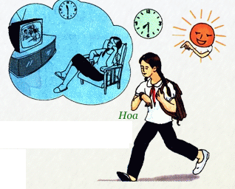
II. GRAMMAR
* Why – Because
Model sentences:
Why did Hoa go to school late this evening?
Because she watched TV late last night.
Notes:
- Why …?: ask for reasons
- Because … : give reasons

Slide 34
I. Matching
A | B
1.Why didn’t Nam come to the party? | a. Because they’ll have an appointment at ten.
2.Why were you late ? | b. Because she had to finish the report.
3.Why do they have to live soon? | c. Because he had a lot of homework to do.
4.Why are you laughing? | d. Because we missed the 1st bus.
5.Why don’t you take a taxi? | e. Because the stories are so funny.
6.Why did your sister stay late at the office? | f. Because I don’t have enough money.
7.Why couldn’t Jane pass the final exam? | g. Because she didn’t study hard enough.
Answers
1. __
2. __
3. __
4. __
5. __
6. __
7. __

Slide 35
I. Matching
A | B
1.Why didn’t Nam come to the party? | a. Because they’ll have an appointment at ten.
2.Why were you late ? | b. Because she had to finish the report.
3.Why do they have to live soon? | c. Because he had a lot of homework to do.
4.Why are you laughing? | d. Because we missed the 1st bus.
5.Why don’t you take a taxi? | e. Because the stories are so funny.
6.Why did your sister stay late at the office? | f. Because I don’t have enough money.
7.Why couldn’t Jane pass the final exam? | g. Because she didn’t study hard enough.
Answers
1. c
2. d
3. a
4. e
5. f
6. b
7. g

Slide 36
II. Make questions with Why
Huy was sad because he failed the exam.
Why was Huy sad?
2. I was late for work because my car broken down.
Why were you late for work?
3. He cut himself because he was careless.
Why did he cut himself?
4. Ted can’t drive a car because he is not old enough.
Why can’t Ted drive a car?

Slide 37
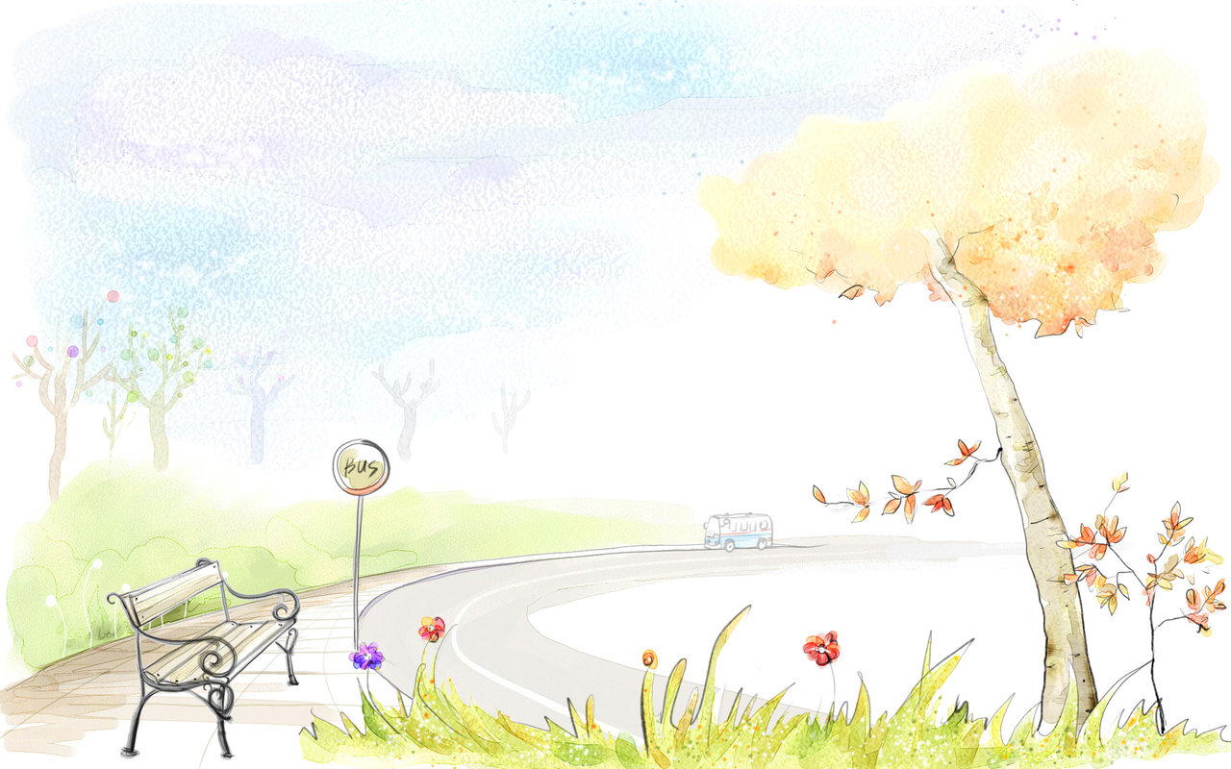
THANK YOU FOR YOUR ATTENTION

Slide 38
ENGLISH 8
Unit 3: AT HOME
Write

Slide 39
Unit 3: AT HOME
Write
I. VOCABULARY
wardrobe /ˈwɔːdrəʊb/ (n): tủ quần áo
cupboard /ˈkʌbəd/ (n): tủ
folder /ˈfəʊldə(r)/ (n): bìa tài liệu
refrigerator /rɪˈfrɪdʒəreɪtər/ = fridge (n): tủ lạnh
tower rack /taʊər ræk / (n): giá phơi khăn
jar /dʒɑː(r)/ (n): lọ, bình
beneath /bɪˈniːθ/ (pre): ở dưới
corner /ˈkɔːnə(r)/ (n): góc
counter /ˈkaʊntə(r)/ (n): quầy

Slide 40
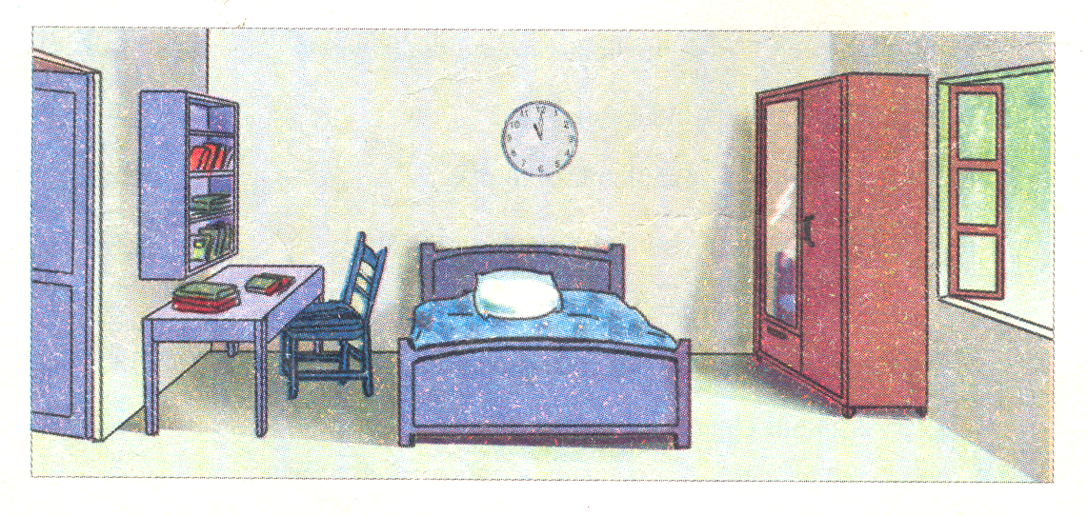
1. Read the description of Hoa’s room and find out the prepositions of place
On the left of
On
On the right side of
Near
Above
Beside
Opposite

Slide 41
Look at the picture and answer these questions
Where is the desk?
What are there on the desk?
What is there on the right side of the room?
Where is the clock?
Where is the wardrobe?

Slide 42
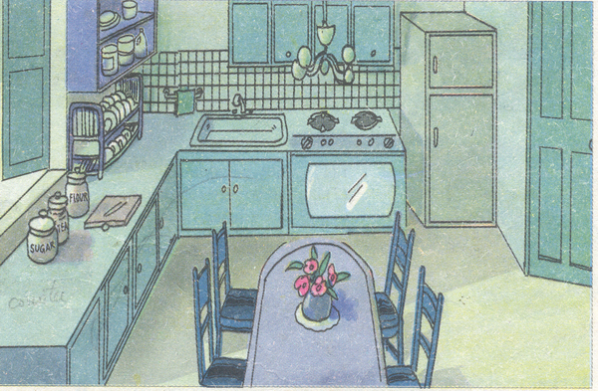
2. Write a description of this kitchen with the given clues.
a. This / Hoa’s kitchen
→ This is Hoa’s kitchen
b. There / refrigerator/ right corner/ room.
→ There is a refrigerator on the right corner of the room.
c. Next to/ refrigerator/ stove and/ oven.
→ Next to the refrigerator, there is a stove and an oven.

Slide 43
d. On the other side/ oven/ sink/ next to sink/ towel rack.
→ On the other side of the oven, there is a sink and next to the sink is a towel rack.
e. Dish rack/ counter/ to the right/ window/ beneath/ shelves.
→ The dish rack is on the counter to the right of the window and beneath the shelves.
f. On/ counter/ beneath/ window/ jars/ sugar/ flour/ tea.
→ On the counter beneath the window, there are jars of sugar, flour and tea.
g. In the middle/ kitchen/ table/ four chairs.
→ In the middle of the kitchen, there is a table and four chairs.
h. Lighting fixture/ above/ table/ beneath/ lighting fixture/ vase with flowers.
→ The lighting fixture is above the table, beneath the lighting fixture is a vase with flowers.
Notes:
M,m,mm,oi

Slide 44
2. Write a description of this kitchen.
This is Hoa’s kitchen. There is a refrigerator in the right comer of the room. Next to the refrigerator is a stove and oven. On the other side of the oven, there is a sink and next to the sink is a towel rack. The dish rack is on the counter to the right of the window and beneath the shelves. On the counter beneath the window, there are jars of sugar, flour and tea. In the middle of the kitchen, there is a table and four chairs. The lighting fixture is above the table and beneath the lighting fixture is a vase with flowers.

Slide 45
3. Homework.
Write a description of your bed room / living room.
Learn by heart the new words
Prepare lesson Language Focus

Slide 46
THANK YOU FOR YOUR ATTENTION

